Slide 1
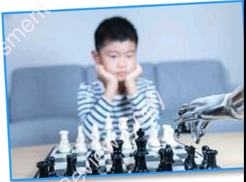
Planning Flowcharts
Computational Thinking & Programming — Topic 1.1
Shapes, activities and predicting outcomes

Slide 2

What is a Flowchart?
A flowchart is a diagram that shows the steps of an algorithm in order.
Each step is inside a shape. Arrows show which step comes next.
Flowcharts help us plan, explain and test an idea before we build it (e.g. in Scratch).
Everyday example: a morning routine – wake up, brush teeth, get dressed, eat breakfast.
Morning routine = an algorithm!

Slide 3
Flowchart Shapes: Meaning & When to Use
Oval / Rounded rectangle – Terminator
Start and End of the flowchart. Use it only at the beginning and the end. e.g. “Start / End”
Rectangle – Process
An action or step to do. Use it for most instructions. e.g. “Brush your teeth”
Diamond – Decision
A Yes/No question. Two arrows leave it, labelled Yes and No. e.g. “Is it a school day?”
Parallelogram – Input / Output
Asking the user for information, or displaying a message. e.g. “Ask for username”
Arrow – Flow line
Joins the shapes and shows the direction to follow. e.g. “Step 1 → Step 2”

Slide 4
How to Read & Draw a Flowchart
Reading
Start at the Start shape and follow the arrows with your finger.
Do every step in order until you reach End.
At a diamond, answer the question and follow the Yes or No arrow.
Drawing
Always begin and end with an oval (rounded rectangle).
Use a diamond for every decision and label both arrows Yes / No.
Arrows must point in the correct direction – a “No” arrow can go back to an earlier step (a loop) or join another path.
Start
Do a step
Question?
No
Yes
End

Slide 5
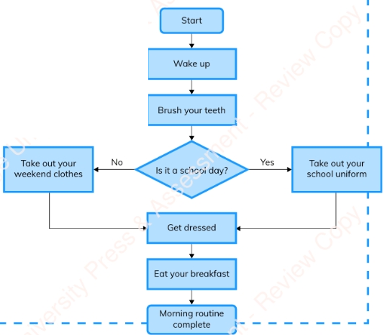
Unplugged Activity 2: Morning Routine
What we do
Work with a partner.
Follow the flowchart twice: once as a school day and once as a weekend.
Use your finger to trace the arrows.
Then ask: What do you notice?

Slide 6
Activity 2: What Do We Notice?
Observations
Both runs start and end the same way.
The diamond “Is it a school day?” sends us down a different path.
Yes → Take out your school uniform. No → Take out your weekend clothes.
Both paths join again at “Get dressed”, then continue.
So a flowchart can have different routes but one ending.
Question 1
What is the difference between the cereal flowchart and the morning routine flowchart?
Answer
The cereal flowchart is a simple sequence – steps one after another with no decisions. The morning routine has a decision diamond with Yes/No branches, so there are two possible paths.

Slide 7
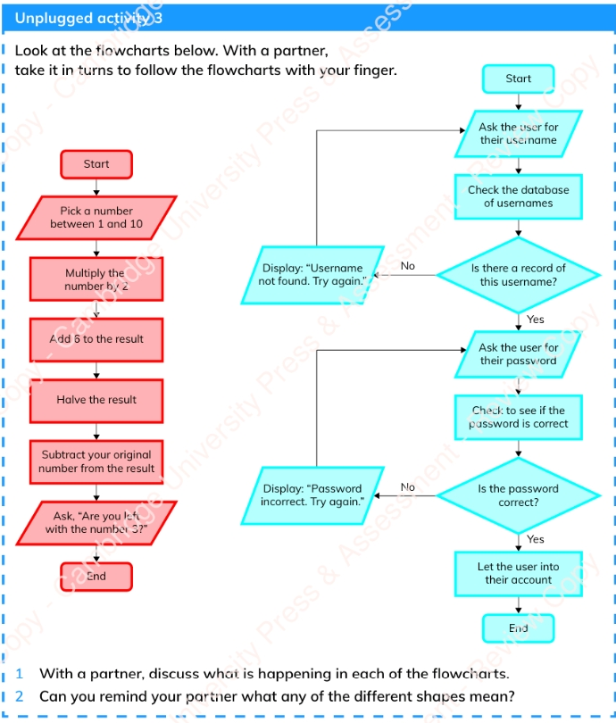
Unplugged Activity 3: Two Flowcharts
What we do
With a partner, take turns following each flowchart with your finger.
Discuss
1) What is happening in each flowchart?
2) Can you remind your partner what each shape means?
Tip
Look at the colours: red = number trick, blue = login.

Slide 8
Activity 3: What Is Happening?
Red: Number trick
Pick a number between 1 and 10 (input).
×2 → +6 → halve it → subtract your original number.
Example: 4 → 8 → 14 → 7 → 3.
Answer is always 3, so the question “Are you left with the number 3?” always works!
No decisions: just a sequence.
Blue: Login system
Ask for username (parallelogram) → check database.
Diamond: is there a record? No → display “Username not found” and ask again. Yes → continue.
Ask for password → check it.
Diamond: correct? No → “Password incorrect”, try again. Yes → let user into account.
Uses loops: the No arrows go back.

Slide 9
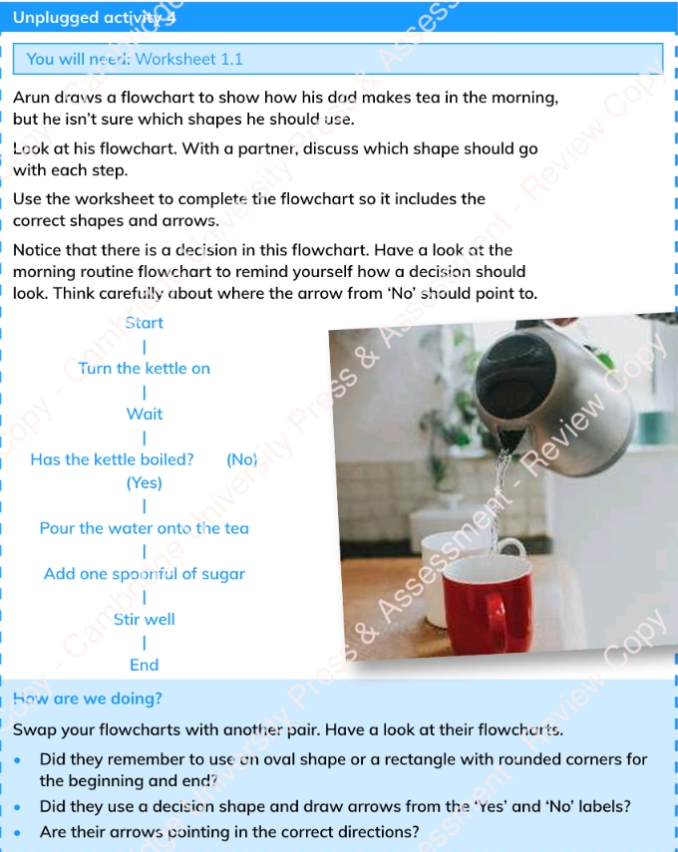
Unplugged Activity 4: Arun’s Tea Flowchart
What we do
Arun drew a flowchart for how his dad makes tea but used no shapes.
With a partner, decide which shape goes with each step.
Use Worksheet 1.1 to redraw it with the correct shapes and arrows.
Remember: a decision needs Yes and No arrows – think carefully where “No” should point!
Swap and check
Oval for start/end? Decision diamond with Yes/No labels? Arrows pointing correctly?

Slide 10
Activity 4: The Completed Flowchart
Start
Why these shapes?
Start / End → oval.
Turn on, Wait, Pour, Add, Stir → rectangles (actions).
Has the kettle boiled? → diamond (Yes/No question).
Yes → go on to pour the water.
No → arrow goes back to “Wait”, so we wait and check again (a loop).
Turn the kettle on
Wait
Has the kettle boiled?
No
Yes
Pour the water onto the tea
Add one spoonful of sugar
Stir well
End

Slide 11
Questions 2–4 and Activity 5
Answers
Q2. What shape at the start and end? An oval or rectangle with rounded corners (terminator).
Q3. When use a rectangle? For a process – an action or instruction step.
Q4. Why a diamond? For a decision – a Yes/No question that splits the path in two.
Activity 5: Make a poster
Need: computer, laptop or tablet + Word, PowerPoint or Canva.
Create a poster that explains what each flowchart shape means.
Add pictures and colour to make it interesting.
Include: oval, rectangle, diamond, parallelogram, arrow – with a short example for each.

Slide 12
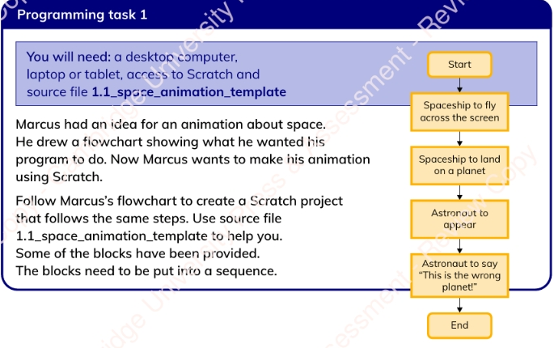
Programming Task 1: Following a Flowchart
What we do
Marcus drew a flowchart for a space animation. Build it in Scratch.
Open source file 1.1_space_animation_template.
Some blocks are already given – put them in a sequence.
Flowchart → Scratch
Fly across screen → glide block.
Land on planet → glide / move to planet.
Astronaut appears → show block.
Says “This is the wrong planet!” → say block.
Rectangle steps = blocks; the order of the arrows = the order of the blocks.

Slide 13
How Am I Doing? & Predicting Outcomes
Check your Scratch code:
Spaceship flies across the stage.
Spaceship looks like it lands on a planet.
Astronaut appears after landing.
Astronaut says something. (1 point each)
Prediction = saying what you think will happen in the future.
If you understand a flowchart, you can predict a robot’s next chess move.
People use complex flowcharts to predict real things: who needs healthcare, or if the price of gold will rise or fall.
To predict the outcome: follow every step to the end.

Slide 14
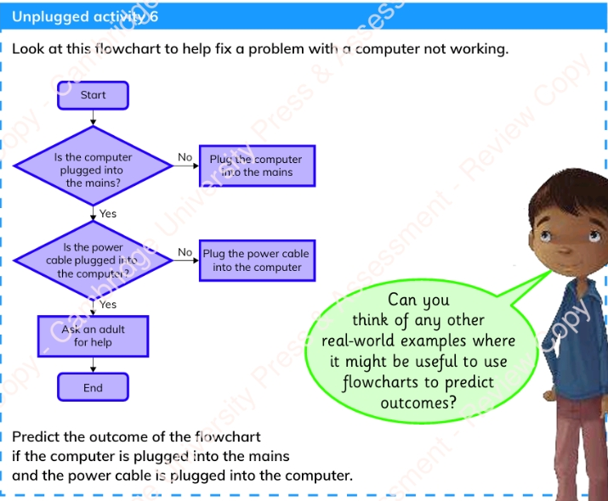
Unplugged Activity 6: Fix the Computer
What we do
Use the flowchart to fix a computer that is not working.
Predict the outcome when the computer is plugged into the mains and the power cable is plugged into the computer.
Prediction
Plugged into mains? Yes. Power cable plugged in? Yes.
Both No branches are skipped → “Ask an adult for help” → End.
Think: where else could flowcharts predict outcomes?

Slide 15
Look What I Can Do!
Present algorithms as flowcharts
Know the meaning of different flowchart shapes
Predict the outcome of a flowchart
Terminator (oval): Start / End
Process (rectangle): an action
Decision (diamond): Yes / No question
Input / Output (parallelogram): ask or display
Arrows: show the direction of the flow

